Slide 1
THE i-DELIVER SYSTEM A web-based application that manages the activities of delivery service system by coach
GROUP 18 – FPT UNIVERSITY SUPERVISOR
LONGDBSE60690 NGUYỄN TRỌNG TÀI
LULP60563
TUNGNTSE60609
DUCNTSE60660

Slide 2
TEAM MEMBERS
Supervisor: Nguyễn Trọng Tài
Nguyễn Thanh Tùng
Lê Phúc Lữ
Nguyễn Tấn Đức
Đào Bảo Long

Slide 3
OUTLINE
Scenario problems
Propose solution
Demonstration
Advantages & disadvantages of solution
Future plan
Technology & development environment

Slide 4


CURRENT SCENARIO
Advantages Disadvantages
No need to setup
No training time
Paper documents
No statistics report
Internet connection unnecessary
Ineffective manual work

Slide 5
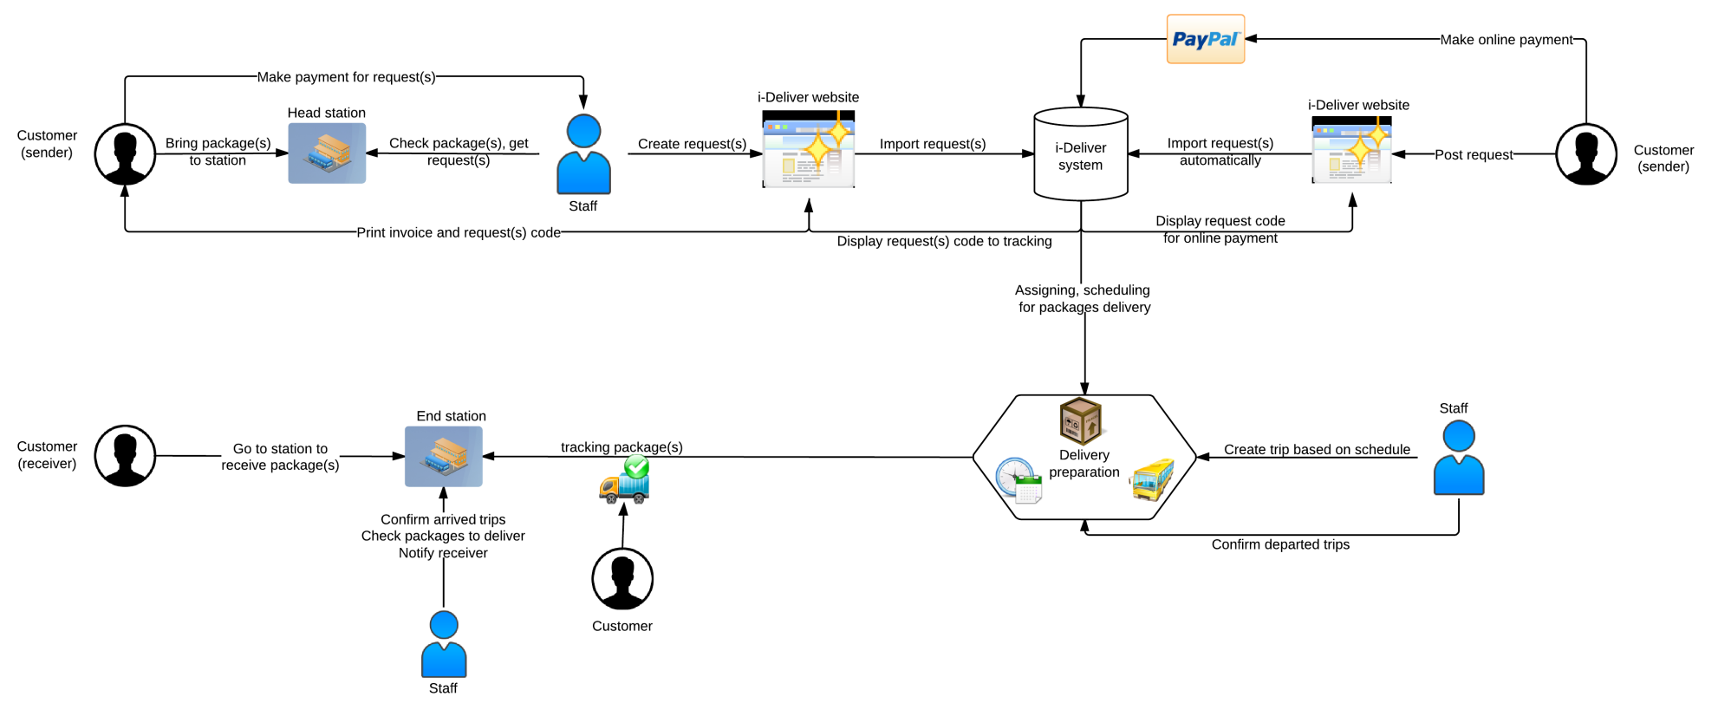
PROPOSE SOLUTION
Notice: This system does not optimize coach scheduling for trip and cost of delivery process.

Slide 6
FEATURES
Online payment
Auto assigning
Easy tracking
Post request online

Slide 7






TECHNOLOGY & DEVELOPMENT ENVIRONMENT

Slide 8
DEMONSTRATION

Slide 9
ADVANTAGES OF NEW SYSTEM
Request for goods delivery easily
Simple ways tracking packages
Online payment every time everywhere
Customers can rate and comment about station’s service
Easy to manage package(s), less hand work, less paper document
Small installation cost, easy deployment
Statistics on performance, revenue

Slide 10


DISADVANTAGES OF NEW SYSTEM
Each station must have a staff with basic computer skills to import request manually
Each station must have a computer with internet connection

Slide 11



FUTURE PLAN
Develop and optimize algorithms for coach scheduling and reduce cost of delivery process
Develop mobile applications for manage package(s) pick-up/delivery process at customer’s house

Slide 12
Thanks for listening Q&A

